Slide 1
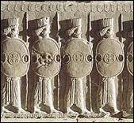
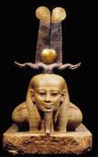
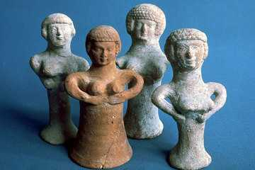
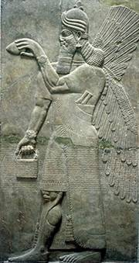
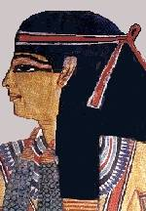
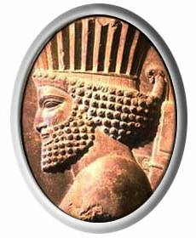
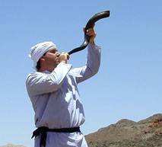
The Ancient
Middle East

Slide 2
https://image1.slideserve.com/1700436/mesopotamia-n.jpg

Slide 3
1. Mesopotamia:
"Land Between
the Two Rivers"

Slide 4
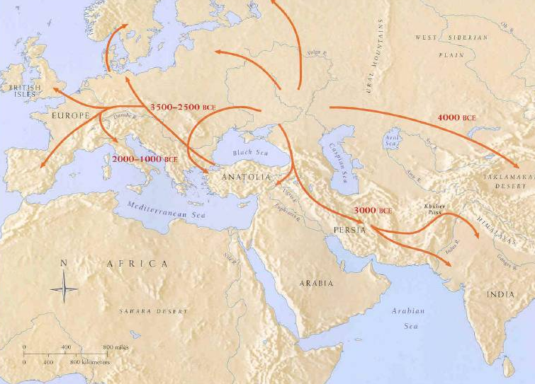
Indo-European Migrations: 4m-2m BCE
The Middle East: “The Crossroads of Three Continents”

Slide 5
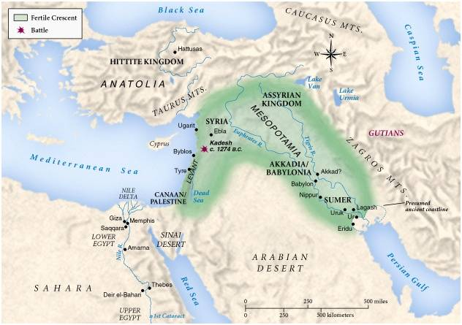
The Ancient Fertile Crescent Area
The Middle East: “The Cradle of Civilization”

Slide 6
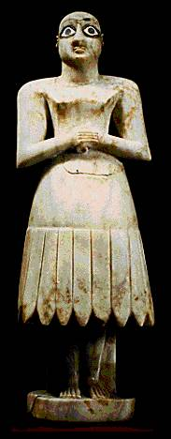
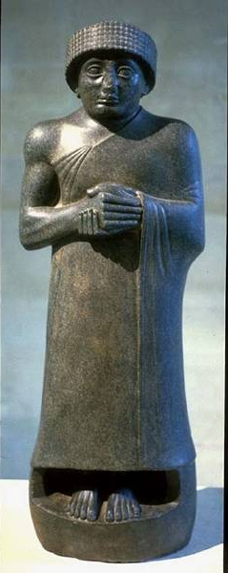
Sumerians

Slide 7
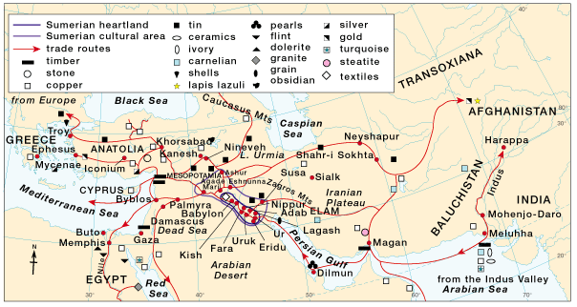
Mesopotamian Trade
“The Cuneiform World”

Slide 8
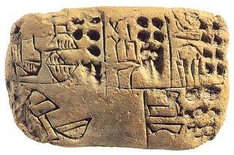
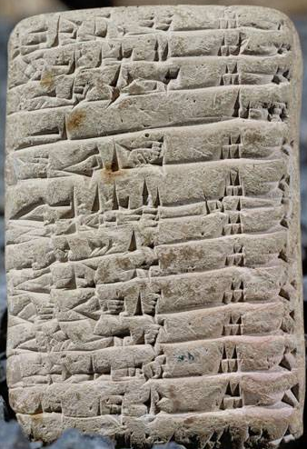
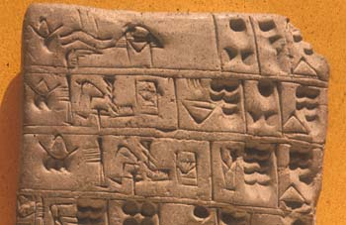
Cuneiform: “Wedge-Shaped” Writing

Slide 9
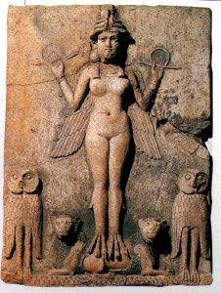
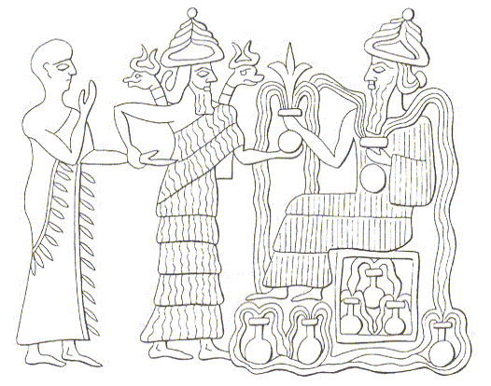
Sumerian Religion - Polytheistic
Innana
Enki
Anthropomorphic Gods

Slide 10
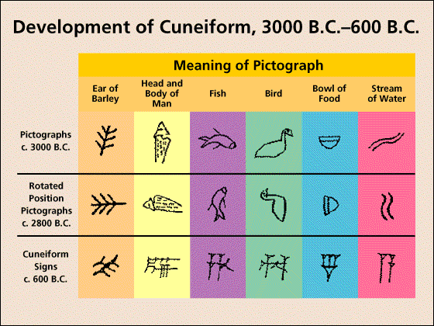
Cuneiform Writing

Slide 11
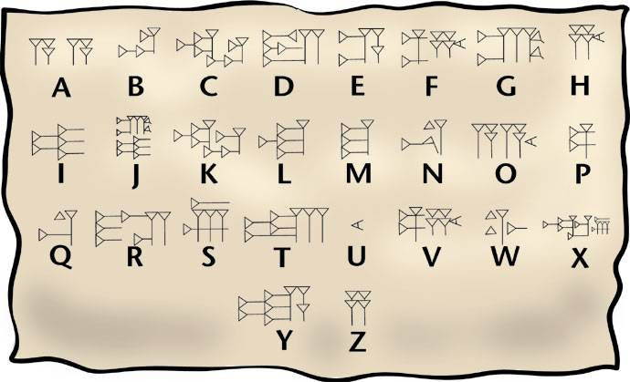
Deciphering Cuneiform

Slide 12
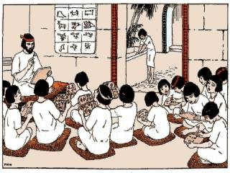
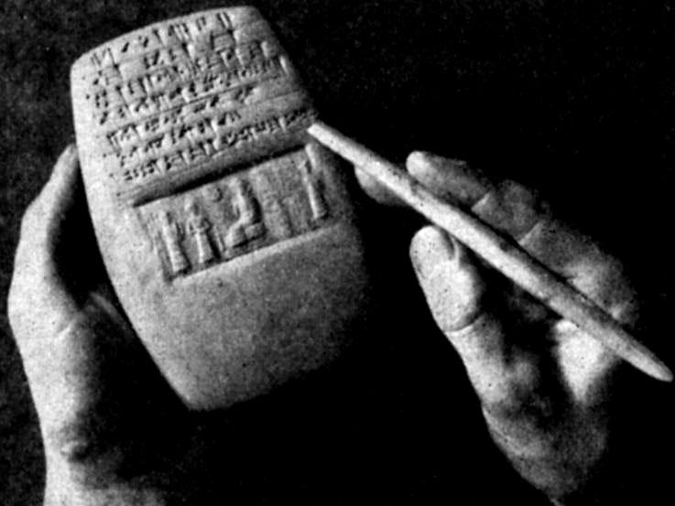
Sumerian Scribes
“Tablet House”

Slide 13
Sumerian Cylinder Seals

Slide 14
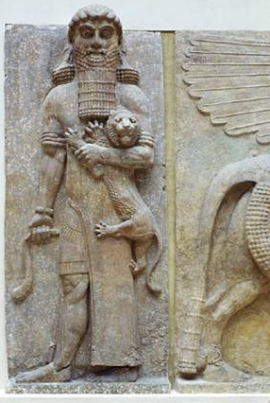
Gilgamesh

Slide 15
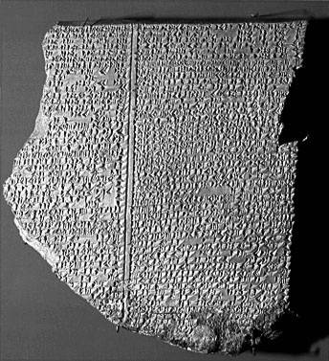
Gilgamesh Epic Tablet: Flood Story

Slide 16
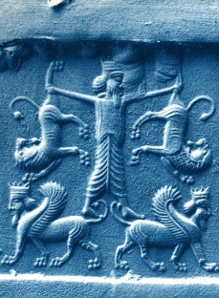
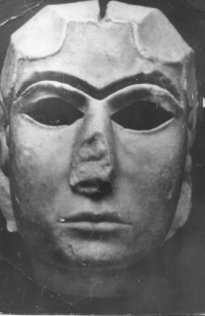
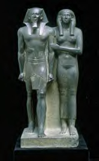
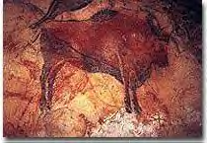
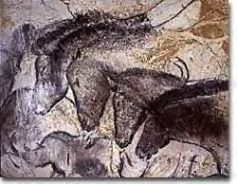
The Epic of Gilgamesh and
Ancient Mesopotamia
The history and culture behind the world’s oldest recorded story – Epic of Gilgamesh

Slide 17
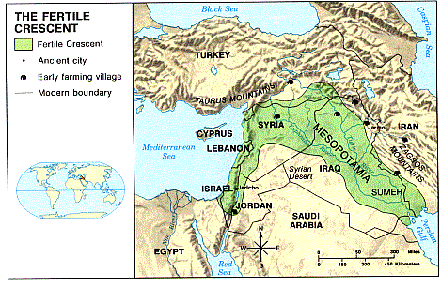
Mesopotamia– Geography (circa 4000 BC)
Mesopotamia means “the land between the rivers.”
It is located in an agriculturally rich region between the Tigris and Euphrates rivers (also known as the “Fertile Crescent” or “cradle of civilizations”.
It was located in the region known today as Iraq as well as parts of Iran.

Slide 18
Mesopotamia was a wide plain open for invasion

Slide 19
Mesopotamia’s Ruling Societies from 5000 BCE – 600 BCE
Sumeria was the first civilization in the region.
Later, the Akkadians, Hittites, Babylonians, Assyrians, and Chaldeans take over their cities and adopt their culture.
They all adapt their own version of the Epic of Gilgamesh.

Slide 20
Sumerians (5000-2100 BC)
The Sumerians were the first group of people known to have dominated this region
____________________________________
1. Economy
Sumerians made their living by growing crops and raising livestock. They were also known as successful merchants and traders throughout the Persian Gulf region.

Slide 21
Sumerians (5000-2100 BC)
2. Government and Society
Sumerians lived in city-states. These cities were walled (fortified) for protection and surrounded by vast, open land.
The largest city-states were Ur, Uruk, and Lagash. The Sumerians never developed a central, unifying government between the three, leaving them vulnerable to attack.
Sumerian society developed a three-level class system (nobles, middle class, peasants).

Slide 22
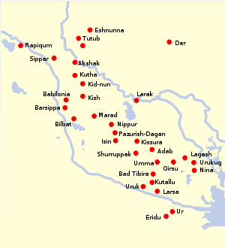
Sumerian City States
City of Uruk setting for Gilgamesh

Slide 23
Sumerians (5000-2100 BC)
3. Religious Beliefs
The Sumerians (and later the Babylonian people) worshipped a pantheon of gods and goddesses, meaning they were polytheistic.
Regardless of one’s actions in life, they did not believe in life after death. They believed that after one dies there is only emptiness.

Slide 24
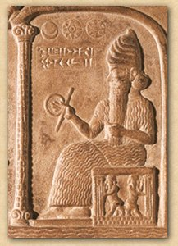
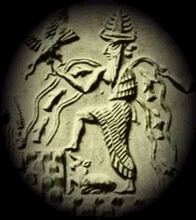
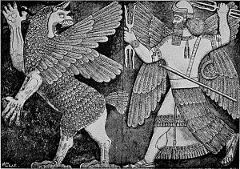
Anu – father of gods and god of the sky (similar to Zeus)
Enlil – god of the air
Utu – sun god;
lord of truth and justice

Slide 25
Sumerians (5000-2100 BC)
4. Cultural Achievements
Sophisticated technology – terraced temples (ziggurats), wheeled vehicles, sail boats, animal-drawn plows.
Developments in math and science – A precise 12 month calendar, the concept of zero, “Pythagorean theorem”

Slide 26
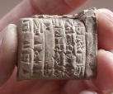
Sumerians (5000-2100 BC)
4. Cultural Achievements (cont.)
World’s first writing system – cuneiform. Formed by reed markings on wet clay tablets.
The Epic of Gilgamesh, the first work of fiction ever recorded, was etched on stone tablets in cuneiform.

Slide 27
King Gilgamesh
Historical king of the Sumerian city-state of Uruk
Figure symbolizing man's vain but endless drive for fame, glory, and immortality

Slide 28
History of Epic of Gilgamesh
While there is no evidence that the events in the epic actually happened, there was a Gilgamesh who ruled the Sumerian dynasty of Uruk in 2,700 BCE
The Epic of Gilgamesh, the first work of fiction ever recorded, was etched on over 40,000 clay tablets in cuneiform in 2,000 BCE.

Slide 29
History of Epic of Gilgamesh
The legend itself was adapted by a number of different cultures following the decline of the Sumerian empire.
We can still learn much about Sumerian culture and values through the story of Gilgamesh – the world’s first epic hero.

Slide 30
Akkadians (2100 - 2000 BC) Hittites (2000 - 1700 BC) Babylonians (1700-700 BC) Assyrians (700-600 BC)

Slide 31
Story of Gilgamesh
The Epic of Gilgamesh is the story of King Gilgamesh of Uruk. Gilgamesh is a ruthless and oppressive leader, and the gods punish his prideful behavior by killing his best friend (Enkidu). Horrified by Enkidu’s death and the prospect of his own demise, Gilgamesh undertakes a quest for immortality, which brings him to the home of Utnapishtim, and the only mortal saved from the Great Flood and granted immortality. There he finds the truth about life and death.

Slide 32
Importance of Gilgamesh
1. Earliest known literary work.
2. Contains an account of the Great Flood and the story of a virtuous man named Utnapishtim who survived
3. Expresses values of ancient civilization – such as the belief in divine retribution for transgressions such as violence, pride, the oppression of others, and the destruction of the natural world.

Slide 33
Importance of Gilgamesh
4. Gilgamesh serves as an early model of the archetypal hero.
5. Studied by Joseph Campbell as a primary example of the monomyth (or hero’s journey story).
6. Large number of parallels to The Odyssey and other Greek epics

Slide 34
Archetypal Traits of the Hero/Heroine
1. Unique birth – the hero’s literal birth or familial origin is uncommon
2. Origin is mysterious – the nature of how the hero became a hero is shrouded in mystery.
3. Extraordinary powers – these do not have to be super powers. These are any ability that makes them extraordinary.
4. Tragic flaw or weakness – every hero has limitations or something that makes them vulnerable. This may be a physical object, a principle, or a disposition.

Slide 35
Archetypal Traits of the Hero/Heroine
5. Rite of passage – every hero goes through tests and training to prove themselves.
6. Has a nemesis – every hero has a main enemy. This villain is often a darker reflection of the hero.
7. Achieves his/her destiny – the archetypal hero always finds success in the long run. In essence, the hero always wins in the end.
8. Stands for good – the hero is a morally and principally good character. S/he never embodies evil qualities beyond momentary weakness.

Slide 36
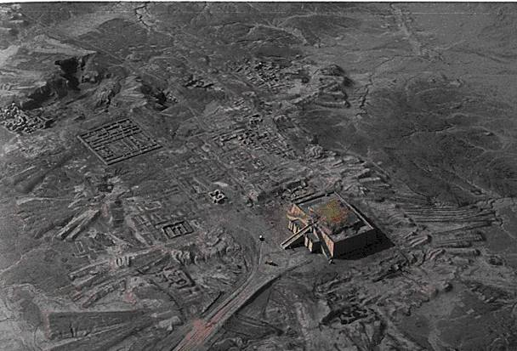
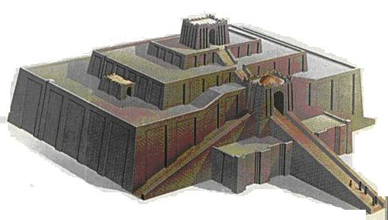
Ziggurat at Ur
Temple
“Mountain of the Gods”

Slide 37
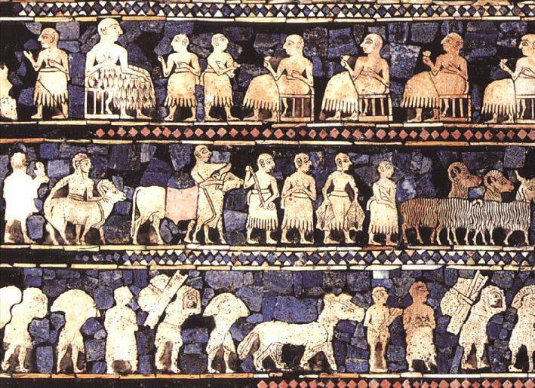
The Royal Standard of Ur

Slide 38
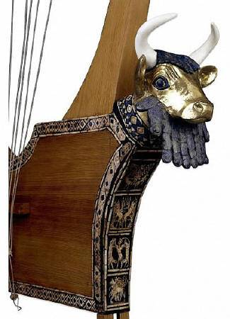
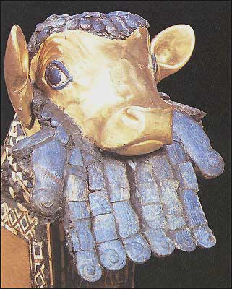
Mesopotamian Harp

Slide 39
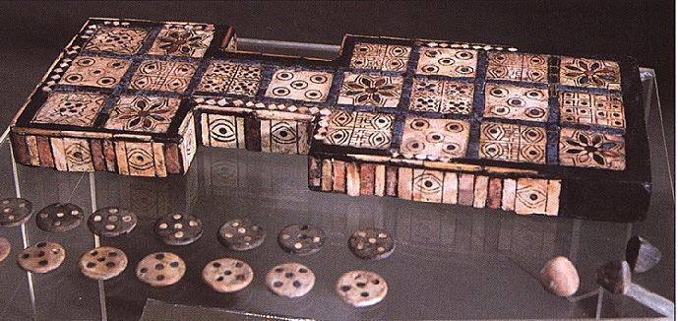
Board Game From Ur

Slide 40
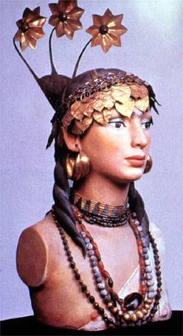
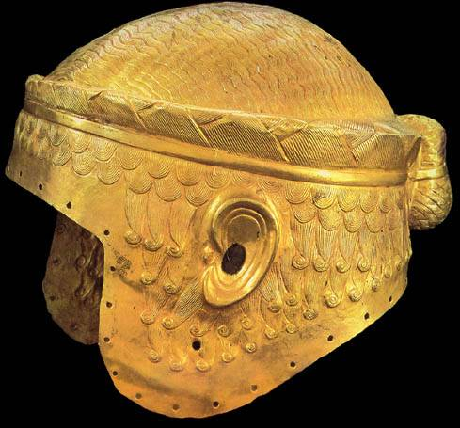
Sophisticated Metallurgy Skills at Ur

Slide 41
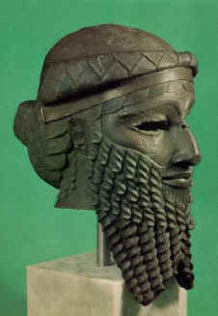
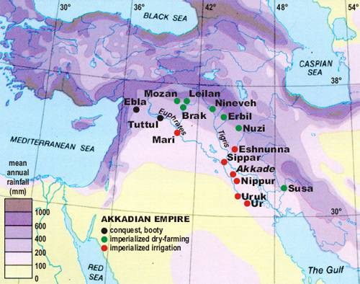
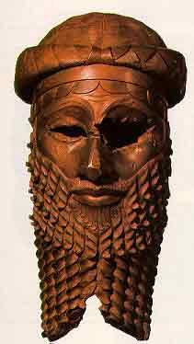
Sargon of Akkad: The World’s First Empire [Akkadians]

Slide 42
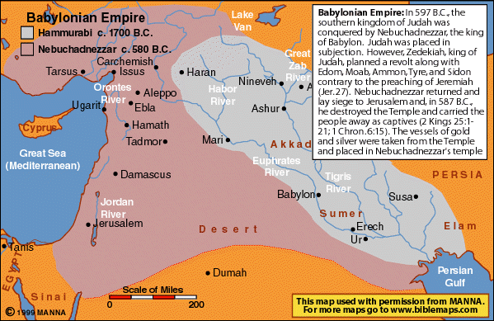
The Babylonian Empires

Slide 43
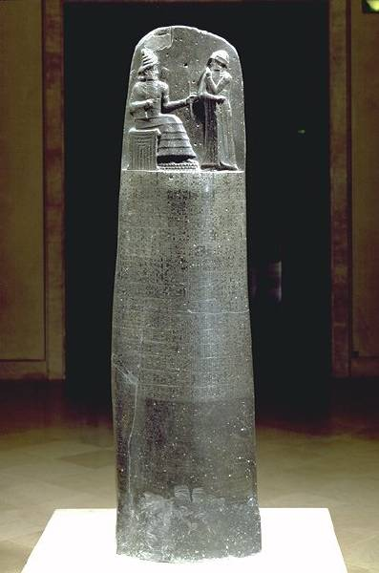
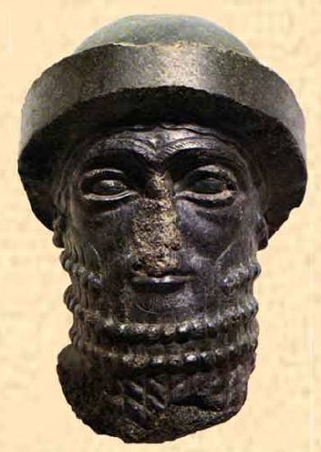
Hammurabi’s [r. 1792-1750 B. C. E.] Code

Slide 44
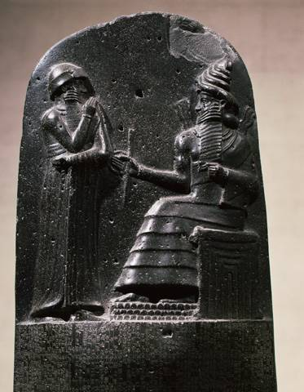
Hammurabi, the Judge

Slide 45
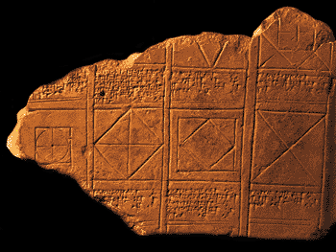
Babylonian Math

Slide 46
Babylonian Numbers

Slide 47
https://www.slideshare.net/patricehigh/mesopotamia-power-point
Slide Show by
Susan M. Pojer Horace Greeley HS Chappaqua, NY

Slide 48
Assyrian Dominates the Fertile Crescent

Slide 49
I. A Might Military Machine
A.) The Rise of a Warrior People
1. Northern Mesopotamia
2. Developed their warlike behavior from
invaders
3. Built empire from east and north of Tigris River to central Egypt

Slide 50
B.) Military Organization and Conquest
Glorified military strength
Soldiers well equipped
Made use of iron-working technology (swords and iron-pointed spears)
No mercy (killed or enslaved)
Advanced planning and technical skills
Lay siege to cities
b. Tunnels, bridges

Slide 51
II. Expanding an Empire
A) Assyrian Rule
Organized conquered territories into an empire
Assyrian officials governed
King chose rulers
New lands brought in taxes and tribute

Slide 52
B) Assyrian Culture
Warriors also great builders (Ex: Great Walled Cities)
Artistic subjects: brutal military campaigns and the lion hunt
Ancient world’s largest libraries

Slide 53
III. The Empire Crumbles
A) Decline and fall
1) Assyrians enemies demolished cities

Slide 54
B) Rebirth of Babylon Under the Chaldeans
1) Babylon defeated Assyrians
2) City of Babylon center
3) Hammurabi
4) King Nebuchadnezzar
5) “Hanging Gardens” one of the Seven Wonders of the Ancient World
6) Highest building, seven-tiered ziggurat
7) Empire fell shortly after Nebuchadnezzar's death

Slide 55
Assyria:850 BC. Acquired a large empire by means of sophisticated military organization and state-of-the-art weaponry.
Sennacherib: Assyrian king sacked 89 cities and 820 villages, burned Babylon.
Nineveh: Assyria’s capital (largest city of its time)
King Ashurbanipal: founded the ancient world’s largest libraries.

Slide 56
Medes & Chaldeans: defeated Assyrian empire
Nebuchadnezzar: Restored Babylon

Slide 57
Causes of Increasing Military Power
Iron-working technology
Advanced planning and technical skill
Ladders (used to scale city’s walls)
Weapons (iron daggers, swords, iron-tipped spears, armor, shields)
Tactics (Savage treatment of defeated opponents)
Tunnels (sappers-soldiers who dug tunnels to sap or undermine the foundation of walls)

Slide 58
Assyria:850 BC. Acquired a large empire by means of sophisticated military organization and state-of-the-art weaponry.
Sennacherib: Assyrian king sacked 89 cities and 820 villages, burned Babylon.
Nineveh: Assyria’s capital (largest city of its time)
King Ashurbanipal: founded the ancient world’s largest libraries.

Slide 59
Causes of Decline Power
Assyrian enemies destroyed cities (burned)
People rejoiced at the destruction of their cities
Assyrian empire spread itself too thin
Cruelty had earned many enemies

Slide 60
What do you think was an effective strategy?
The causes of Assyrian military power
The stability of the empire
The methods that empires use to become stronger.

Slide 61
Government of Mesopotamia

Slide 62
Started as City-States: a city that with its surrounding territory forms an independent state.
Had their own ruler (king)
Position passed through father to son or who the king chose to succeed.
Absolute power and authority

Slide 63
First Empire-Akkad
Akkadians
Conquered areas of Mesopotamia
Trade, land, resources
Controlled cities
King Sargon was the first ruler to unite the peoples of Southern Mesopotamia into a single political unit. He established a strong, centralized state. Cities, though, used to independence competed for preeminence, which appears to have eventually brought about the Empire's decline. It was followed by the Babylonian Civilization. (http://www.newworldencyclopedia.org/entry/Akkadian_Empire)

Slide 64
Babylonian Empires
Hammurabi
Nebuchadnezzar
The city of Babylon was given hegemony over Mesopotamia by their sixth ruler, Hammurabi (1780 B.C.E.; dates uncertain). He was a very efficient ruler, giving the region stability after turbulent times, and transforming what had been an unstable collection of city-states into an empire that spanned the fertile crescent of Mesopotamia.(http://www.newworldencyclopedia.org/entry/Babylonian_Empire )

Slide 65
Following the collapse of the Agade empire, the center of power in southern Mesopotamia shifted to the cities of Uruk and Ur. The governor of Ur, Ur-Nammu, established a dynasty which came to dominate the other cities of the region, and whose territory stretched east into Iran. Under his successor, Shulgi, the empire was consolidated and centralized.
Shulgi was named as a god in many ancient documents. This gave him great power and followed a tradition established by the earlier rulers of Agade. He was succeeded by Amar-Sin and Shu-Sin, under whom many of the communication and supply routes across the empire were disrupted by groups of pastoralists (Amorites). This situation reached crisis point under the next ruler, Ibbi-Sin. With reduced supplies the empire was unable to effectively confront an attack by the Elamites from the east; Ur was destroyed and Ibbi-Sin was taken into exile. http://www.britishmuseum.org/explore/highlights/articles/t/third_dynasty_of_ur_ur_iii.aspx

Slide 66
Mesopotamia Assessment
What were 3 inventions of the Mesopotamians?
What was the ancient government like in Mesopotamia?
What was the significance of a city-state?
What was Gilgamesh known for?
What was the significance of Hammurabi’s code?
Why did Mesopotamia’s location help contribute to its success?
What flaws led to the decline of Mesopotamia?

Slide 67
Iron weaponry; writing system; alphabet & numbers
Absolute power; strong military
City and surrounding territory become independent state
Epic hero; king; harsh ruler
Earliest set of laws
Crossroads between Europe, Africa, Asia; two rivers helped for trade & travel; etc.
Cruel treatment; foreign invaders; etc.

